Slide 1
Introducing Technical Writing
ENCS 282 Technical Writing & Communication

Slide 2
Objectives
Appreciate the nature, purpose & range of technical writing
Understand the challenges faced by technical writers
Learn the value of collaborating with others in producing technical documents
Understand how advances in technology and user expectations require an ‘expanded tool box’

Slide 3
Warm – Up
What jobs require Technical Writing Skills?

Slide 4











Notes:
Written Script:
Medicine, Business, Engineering, Science, Drafting Firefighting, Government, Technology, Trades.

Slide 5
Writing is a part of most careers
Proposing various projects to management or clients
Contributing articles to industry periodicals
Describing products to employees or customers
Writing procedures or instructions for employees or customers
Justifying a request for funding from management or governmental organizations
Editing and reviewing documents written by colleagues
Designing materials that will be read on a screen or transformed into video or audio.

Slide 6
Definition of Technical Writing
Technical Writing conveys a particular piece of information for a particular purpose to a specific reader or group of readers. It aims to create easy access to information.
Technical communicators interpret and transmit specialized information to audiences who may need that information in order to perform a task, answer a question, solve a problem or make a decision.
Notes:
Written Script:
Definition of Technical Writing
Technical Writing conveys easy access to information. Remember a reader of any technical report is looking for specific information. The reader does not have time to sift through paragraphs of verbiage. The reader must find the information in a timely manner. Time in any workplace equates to productivity.
For example, if the supervisor of division # 5 is looking for the yearly allotted budget for division #5, the supervisor does not care about the budgets for division #2, #3, or #4. He or she only cares about the budget for division #5. Therefore, he/she needs to see a heading that clearly identifies Division #5’s budget. In addition, if the supervisor is only looking for a line that tells how much of the budget is allocated for office supplies, he or she needs to see a sub marker, perhaps an indented sub heading or bullet, that identifies the office supplies.
The reader also needs access to clear information. A reader of any technical report does not have time to interpret meaning. The reader needs to be able immediately to grasp the meaning of words.

Slide 7
Why does Technical Writing Exist?
Technical Writing Serves Practical Needs
  Technical documents appeal to our understanding rather than our imagination.
Technical Writing Meet the Audience’s Needs
  Technical documents focus on the audience’s desire for information rather than the writer’s desire for self-expression.
Technical Writing Strives for Efficiency
  In the work place as well as among consumers, people read technical documents for reference. They only want specific information and they also want access to it quickly.

Slide 8
Efficiency Case
Consider the following message:
At this point in time, we are presently awaiting an on-site inspection by vendor representatives relative to electrical utilization adaptations necessary for the new computer installation. Meanwhile, all staff members are asked to respect the off-limits designation of said location, as requested, due to liability insurance provisions requiring the online status of the computer.

Slide 9
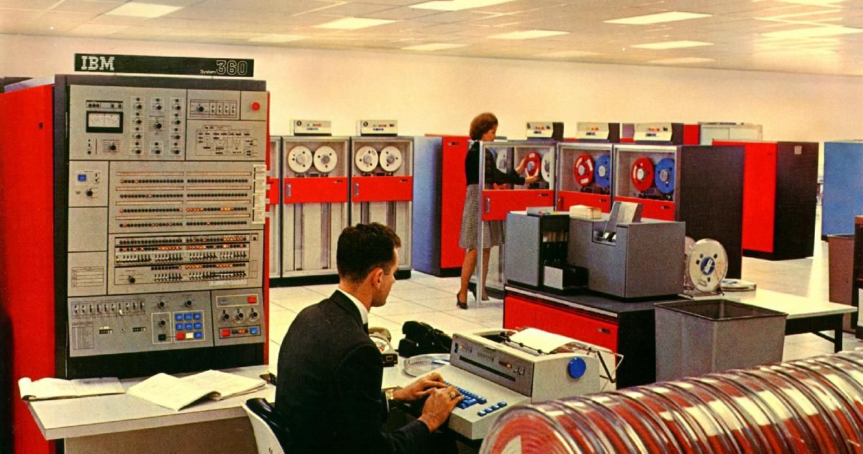
Efficiency Case
Consider the following message:
Hardware consultants will soon inspect our new computer room to recommend appropriate wiring. Because our insurance covers only an operational computer, this room must remain off limits until the computer is fully installed.

Slide 10
Causes of Inefficient Documents
More (or less) information than the readers need
Irrelevant or un-interpreted information
Confusing organization
Jargon or vague technical expressions readers cannot understand
More words than readers need
Uninviting appearance or confusing layout
No visual aids when readers expect them

Slide 11
Words, Phrases, and Sentence Structure
Consider the following statements:
  We need to ascertain the amount of funding for next year’s budget.
  We need to determine the amount of funding needed.
  Find out how much funding was allotted.
  We need to determine how much money we will need next year.
  We need to find out how much money we have in next year’s budget.
Which are the most straightforward? Why?

Slide 12

Using language specific to a particular trade or profession is acceptable and necessary at times.
if
  The message is intended for the members of that particular group.
        if
  The message is intended for individuals outside of the group,
    use plain language.
Notes:
Written Script:
Of course, using language specific to a particular trade or profession is necessary as long as the message is intended for the members of that particular group. However, if the message is intended for individuals outside of the group, again, use plain language, for unquestionable understanding.

Slide 13
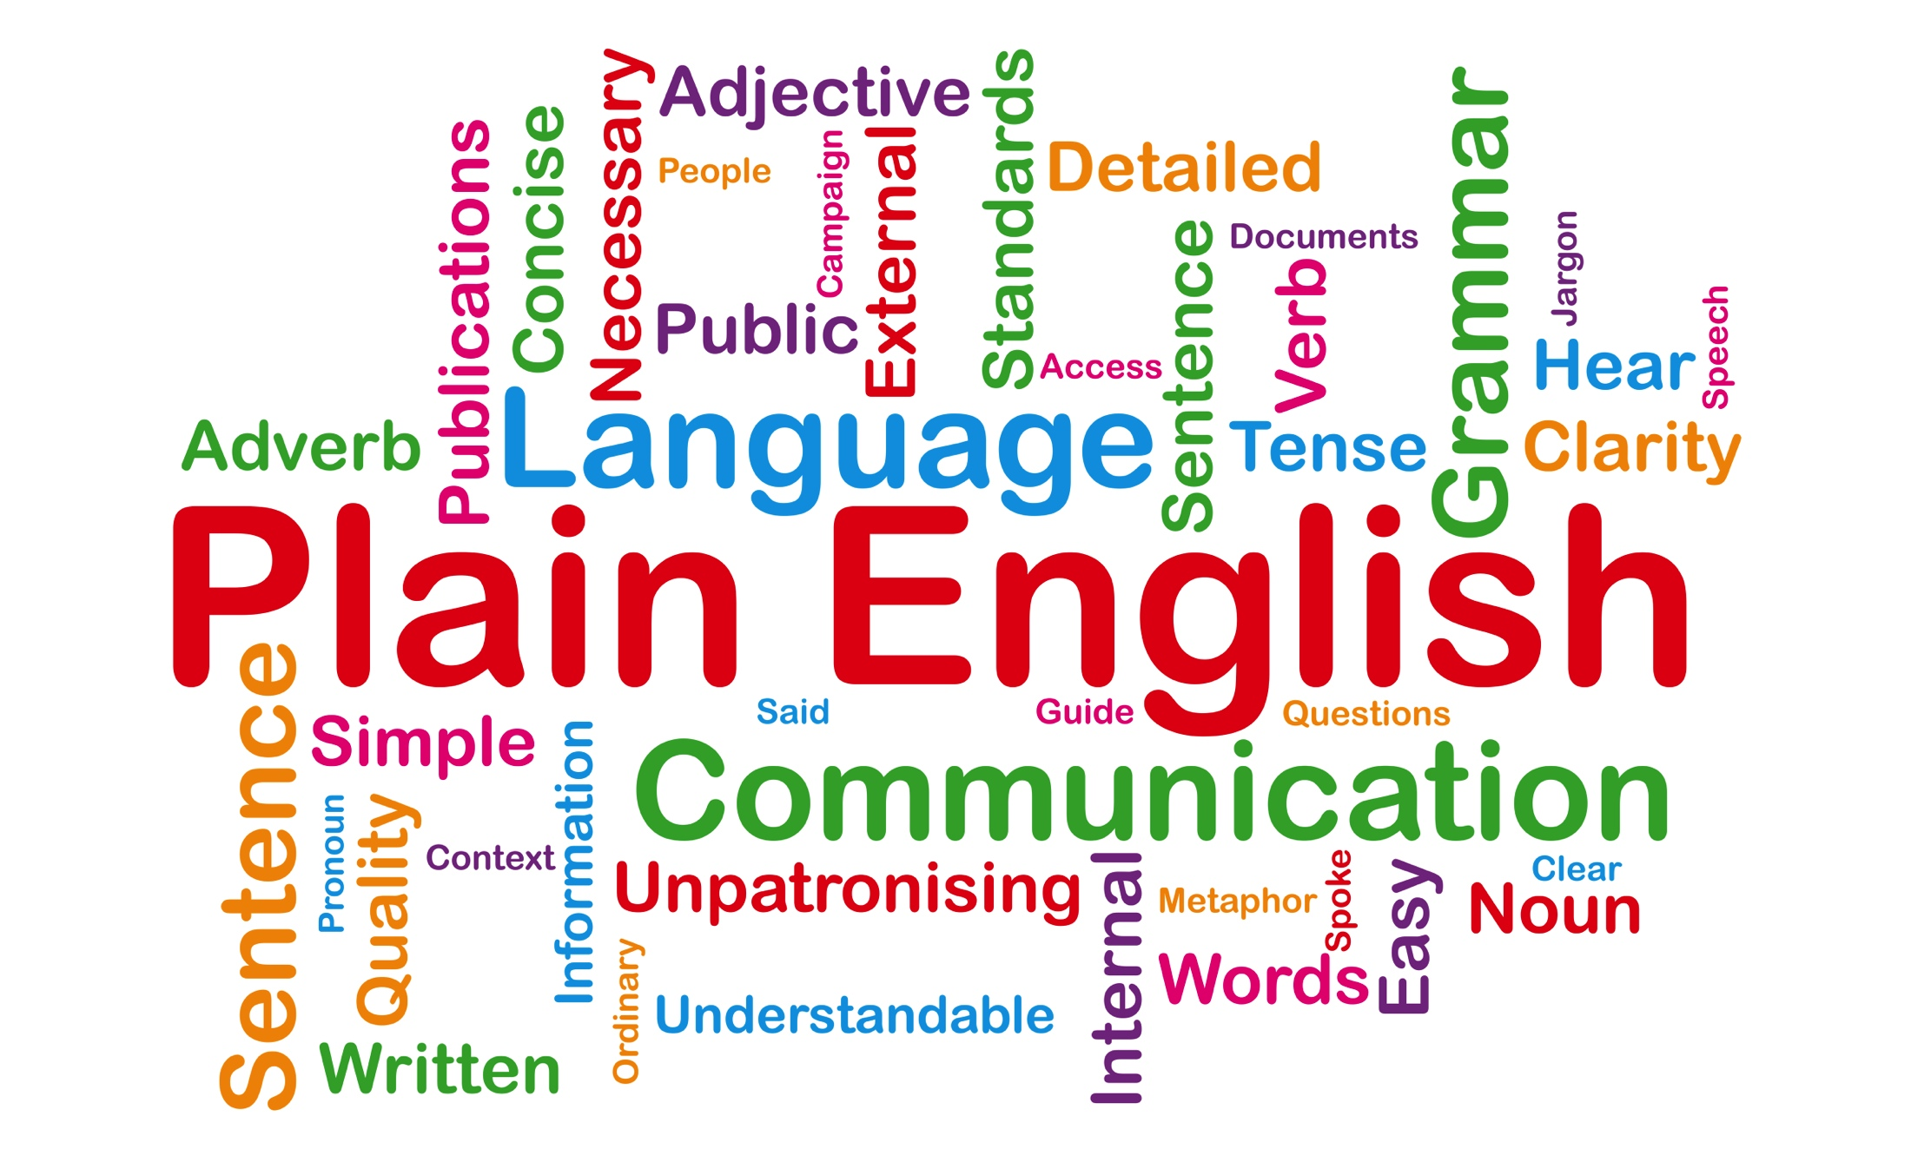
But What is Plain Language?

Slide 14
Plain Language: A variable not a constant
Plain language (also called plain writing or plain English) is communication that your audience can understand the first time they read or hear it.
Writing that is clear, concise, well-organized, and follows other best practices appropriate to the subject or field and intended audience.

Slide 15

Plain Language and Audiences
Language that is plain to one set of readers may not be plain to others. Written material is in plain language if your audience can:
  Find what they need
  Understand what they find
  Use what they find to meet their needs

Slide 16
Plain Language Best Practices
There are several techniques that can help a writer produce plain language documents. The most common are:
Logical organization with the reader in mind
Using “You” and other pronouns
Using Active voice as opposed to passive voice
Shorter sentences (depending on context)
Using more common, everyday words
Easy-to-read design features
Carefully defining any specialty vocabulary or terminology

Slide 17
Case in Point
A customer using an industrial solution, XYZ, to keep the drains in his home clean, wrote to the company who sold the solution to let them know how great their product was.
The company wrote back:
Thank you for writing. The product XYZ has a high vitriolic base. This sulfuric property is excellent for industrial plumbing. We have several solutions for cleaning residential drains. You may want to consider using some of our other excellent products.
The customer promptly replied:
I agree, product XYZ is excellent for keeping the drains in my home clean. I think it is clear that XYZ is the only solution I need to keep using.
With this, the company sent the customer a short, clear two sentence reply:
Do not use product XYZ. Misuse of XYZ will destroy residential plumbing.
Notes:
Written Script:
A customer using an industrial solution, XYZ, to keep the drains in his home clean, wrote to the company who sold the solution to let them know how great their product was.
The company wrote back:
Thank you for writing. The product XYZ has a high vitriolic base. This sulfuric property is excellent for industrial plumbing. We have several solutions for cleaning residential drains. You may want to consider using some of our other excellent products.
The customer promptly replied:
I agree, product XYZ is excellent for keeping the drains in my home clean. I think it is clear that XYZ is the only solution I need t o keep using.
With this, the company sent the customer a short, clear two sentence reply:
Do not use product XYZ. It will destroy residential plumbing.

Slide 18
Differences Between
Academic Writing and Technical Writing
In this section we will discuss the three major components of written communication:
    Purpose,
    Format,
    Language.
Notes:
Written Script:
Differences Between Technical Writing and Academic Writing
In this section we will discuss the major components of written communication:
Purpose,
Format,
Language

Slide 19
Purpose
Academic Writing Persuade Inform Research Purpose Document research/experiment Describe a theory or idea Document types Article Book Monograph | Technical Writing Inform Persuade Guide Research Purpose Supervisor: Order a report Employee: Write a report Needed for decision making Read for Information Reports, Proposals, Manuals
Notes:
Written Script:
While Academic Writing entertains, persuades, or informs, the academic writer may not have a definite purpose to write. A person may decide to write a poem or story, but he or she may have no other intentions than just writing. On the other hand, a person may have a definite purpose for writing. He or she may write a poem or story, article or book for publication. Or maybe complete a written assignment for an instructor.
In contrast, a Technical Writer will have a definite purpose for writing, he or she may write to inform or to persuade, using some type of research. It may or may not be complex research, but the information will be based on some type of expert knowledge. Perhaps a supervisor will order a report or an employee may see a reason to inform others of a specific situation. Regardless, there will be a specific need for the report and the report will be read for its content, information.

Slide 20
Format
Academic Writing Paragraphs Topic Sentences Pictures Charts Reference | Technical Writing Major Headings Sub Headers Markers Bullets Underlings Bold type White Space. Illustrations Graphs Tables Pictures Drawings
Notes:
Written Script:
Format.
Format is probably the most significant difference between Academic Writing and Technical Writing. While Academic Writing is written in paragraphs of plain text, Technical Writing is written in clearly defined major headings, sub heading, and markers. Markers can include bullets, underlining, bold type. Also, technical writing uses plenty of white space. These features provide the easy access to information that many workers need. As we said in the first part of this presentation, a reader of a technical document does not have time to sift through paragraphs of solid text. He/she needs to immediately locate information, and if needed, be able to repeatedly find that same information. Have you ever, after reading an article, tried go back over the article to one particular statement, maybe a fact that you would like to use, and had to scan and reread sections over and over until you found the statement that you just minutes before read. This having to continuously scan and deliberately read is exactly the waste of time that a person who purposefully looking for information needs to avoid, and headings, sub headings, white space and markers let him/her find statements, costs, measurements, immediately.
At times Academic Writing may have pictures. However, usually the pictures are used for emphasis, perhaps a picture will wrapped in text to emphasize the text. However, Technical Writing’s illustrations are used to complement text. A chart, table, drawing is put either above or below the text and separated from the text with white space, so it can be easily seen and interpreted.

Slide 21
Purpose Case
Technical writing, like many other genres has specific goals that it attempts to address. In a university context, it is important to distinguish between academic writing and technical writing because they often have similar features.

Slide 22
Technical Vs. Academic Writing
 | Technical Writing | Academic Writing
Knowledge | Writer has expertise | Writer is a learner
Audience | Technicians, professionals in the field | Scholars, researchers and students
Evaluation | Clear and simple organization; visually appealing and easy to follow, acceptable on the job. | Depth of analysis, logic, clarity, unit and grammar; peer-reviewed and critiqued.
Visuals | Graphics, charts, tables are used to support conclusions or demonstrate principles. | Graphics, charts, tables are sometimes used to explain and demonstrate knowledge.

Slide 23
Tasks Common to Academic and Technical Writing
Academic Writing | Technical Writing
Descriptive Writing | Job description, Incident Report, Résumé, Process Explanation
Narrative Writing | Observation Report, Progress Report
Analysis | Performance Evaluation, Feasibility Report
Cause and Effect | Analytical Report, Product Field Test Report
Compare-Contrast | Product Comparison, Feasibility Report
Persuasive Writing | Proposal, Action Plan

Slide 24
Language
Academic Writing Words Elaborate Transitions Cogitative Polysemous (multiple meanings) Sentence Structure Complex Synonyms Passive voice Scholarly Diction | Technical Writing Words Active vocabulary Plain Easily understood Objective Non-sexist Often avoids pronouns Sentence Structure Uncomplicated Repetitive Active voice
Notes:
Written Script:
Language:
Words and sentence structure are noticeably different between Academic Writing and Technical Writing. While words and sentence structure used in Technical Writing: plain, easily understood vocabulary; straight forward sentence structure, without transition or excessive words, would not express the meaning that the academic writer intends to convey to his reader, neither would words and sentence structure used in Academic Writing be used in Technical Writing. A technical writer would not use the elaborate vocabulary or the complex sentence structure, with excessive words and transitions, of Academic Writing. In a technical document, the use of transitions, multiple meaning words and complex sentence structure, with transitions and embellishment, would not send the straightforward message a technical reader needs in order to quickly understand what he/she needs to do. The language used in Technical Writing must be direct and to the point, intentionally conveying to the reader the information he/she needs to clearly understand what needs to be done. Therefore a technical writer uses active vocabulary, which are plan, easily understood words; uses objective words, words that do not need to be interpreted; and avoids using pronouns. To many times, pronouns do not correctly identify their intended reference. For example, in the sentence: “The staff worked hard all year with the administrators, give them a bonus,” who is them? In this sentence, them refers to the administrators. Therefore, the administrators will get the bonus. The sentence should have been written, “The staff worked hard all year with the administrators, give the staff a bonus.” Is this redundancy? No this is repetition, and in Technical Writing, repetition is necessary for clear understanding.

Slide 25
Conclusion
This presentation included an extended definition of Technical Writing, expressing the need for easy access to information, and briefly defined the differences between Academic Writing and Technical Writing, according to purpose, format and language.
Think about the significance of a technical writer communicating in clear straightforward vocabulary and sentence structure to convey information.
Remember; if the intended reader is not able to quickly understand the message or misinterprets the information, the technical writer has failed; the purpose of the message was lost.
Notes:
Written Script:
This presentation included an extended definition of Technical Writing, expressing the need for easy access to information, and briefly defined the differences between Academic Writing and Technical Writing, according to purpose, format and language.
Think about the significance of a technical writer communicating in clear straightforward vocabulary and sentence structure to convey information.
Remember; if the intended reader is not able to quickly understand the message or misinterprets the information, the writer failed; the purpose of the message was lost.
Click on screen to end the presentation.

Slide 26
How you can improve
Be curious!
Be empathetic with your audience!
READ a lot!
Proofread, Proofread, Proofread!
Practice – write every chance you get.
Get feedback, and then USE it.

